Slide 1


SUBMITED BY
ZAIN , IBRAHIM , SHAH MUHAMMAD SIDDIQU , AMEEN.
Of batch PR2-202310B1 (TTS) have successfully completed the given task for the topic
FACULTY: MIS AQSA NOOR
SECOND SEMESTER DISM
APTECH LEARNING SHAHRAH-E-FAISAL

Slide 2
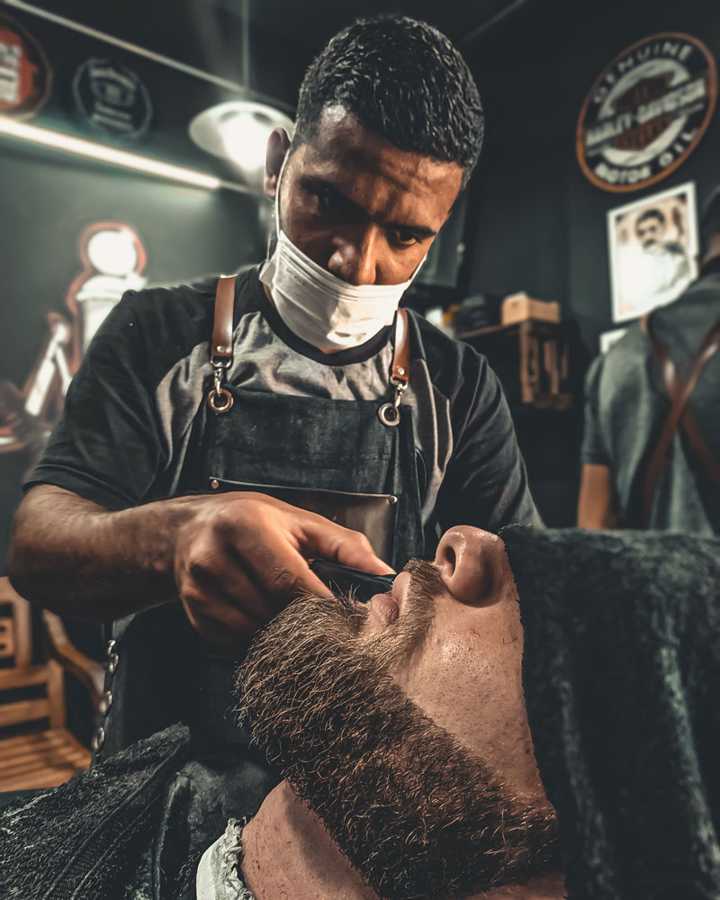
INTRODUCTION
the perfect blend of style, care, and comfort at Over Hair Care. Our expert stylists are dedicated to enhancing your natural beauty with personalized treatments and trendy cuts. Whether you need a fresh look, color transformation, or nourishing treatments, we’re here to make every visit a rejuvenating experience. Pamper yourself—you deserve it!
ACKNOWLEDGE
The thirst for learning, upgrading technical skills and applying the concepts in real life environment at a fast pace is what the industry demands from IT professionals today. However busy work schedules, far-flung locations, unavailability of convenient time-slots pose as major barriers when it comes to applying the concepts into realism. And hence the need to look out for alternative means of implementation in the form of laddered approach. The above truly pose as constraints especially for our students too! With their busy schedules, it is indeed difficult for our students to keep up with the genuine and constant need for integrated application which can be seen live especially so in the field of IT education where technology can change on the spur of a moment. Well, technology does come to our rescue at such times!! Keeping the above in mind and in tune with our constant endeavour to use technology in our training model, we at Aptech have thought of revolutionizing the way our students learn and implement the concepts using tools themselves by providing a live and synchronous e-Project learning environment!

Slide 3
WHAT IS THIS E-PROJECT?
e-Project is a step-by-step learning environment that closely simulates the classroom and Lab based learning environment into actual implementation. It is a project implementation at your fingertips!! An electronic, live juncture on the machine that allows you to
⦁ Practice step by step i.e. laddered approach.
⦁ Build a larger more robust application.
⦁ Usage of certain utilities in applications designed by user.
⦁ Single program to unified code leading to a complete application.
⦁ Learn implementation of concepts in a phased manner.
⦁ Enhance skills and add value.
⦁ Work on real life projects.
⦁ Give a real life scenario and help to create applications more complicated and useful.
⦁ Mentoring through email support.
OBJECTIVE OF E-PROJECT
The Objective of this program is to give a sample project to work on real life
projects. These applications help you build a larger more robust application.
The objective is not to teach you the concepts but to provide you with a real life
scenario and help you create applications using the tools.
You can revise them before you start with the project.
It is very essential that a student has a clear understanding of the subject.
Kindly get back to eProjects Team in case of any doubts regarding the
application or its objectives.

Slide 4
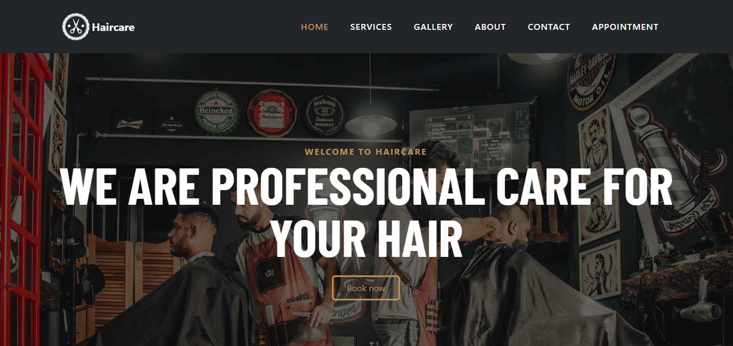
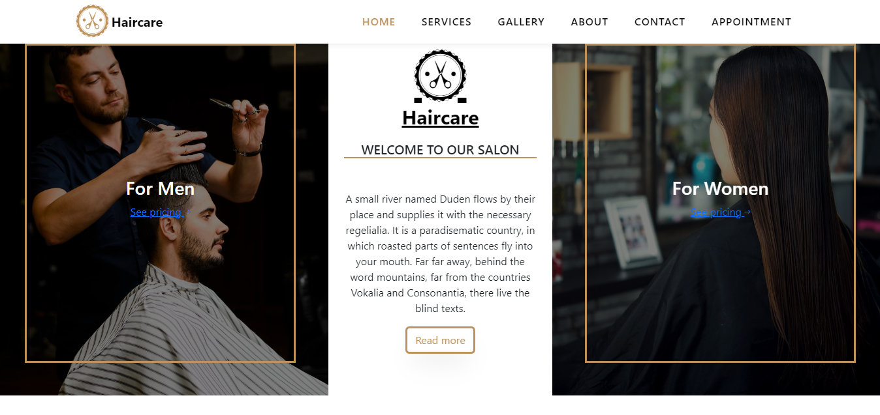
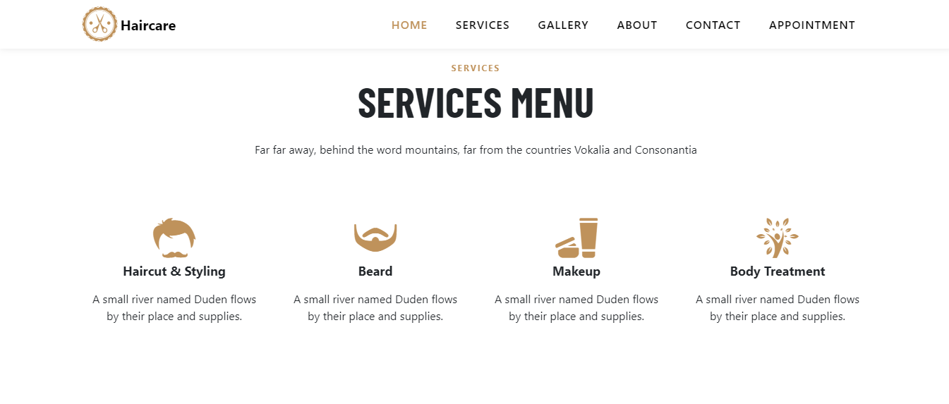
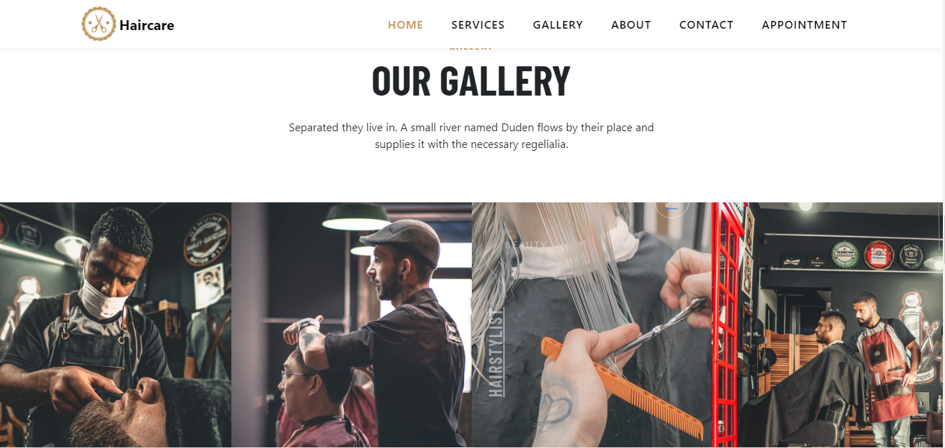
Functional Requirements
The following are the key features and functionality expected from the application:
Home Page:
The home page should be designed to provide an engaging and informative experience for
users. It should display information about the Elegance Salon with some images.

Slide 5
User Authentication and Access Control:
The system should support different user roles (admin, receptionist, stylist) with distinct access permissions.
Users should log in securely using username/email and password authentication.
The system should support role-based access control with distinct permissions for admin, receptionist, and stylist. Users must securely log in using a username or email with password authentication.

Slide 6
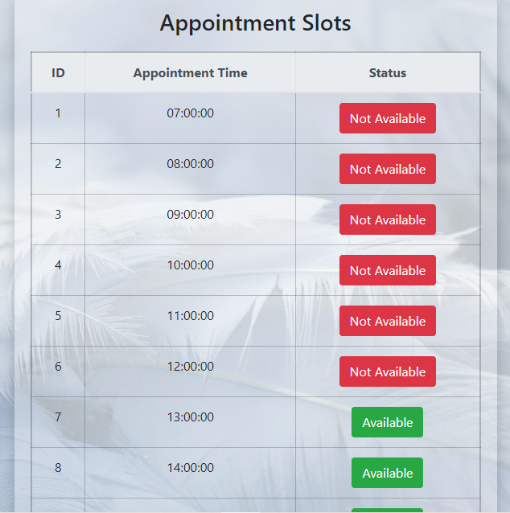
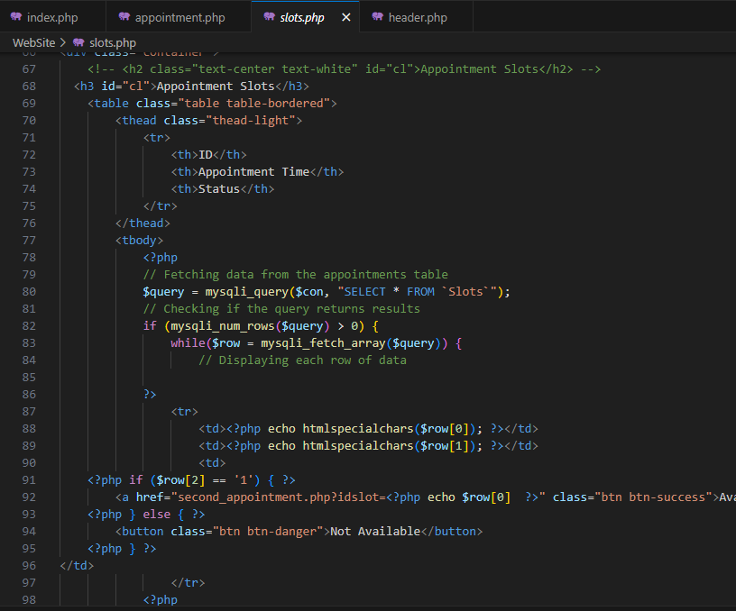
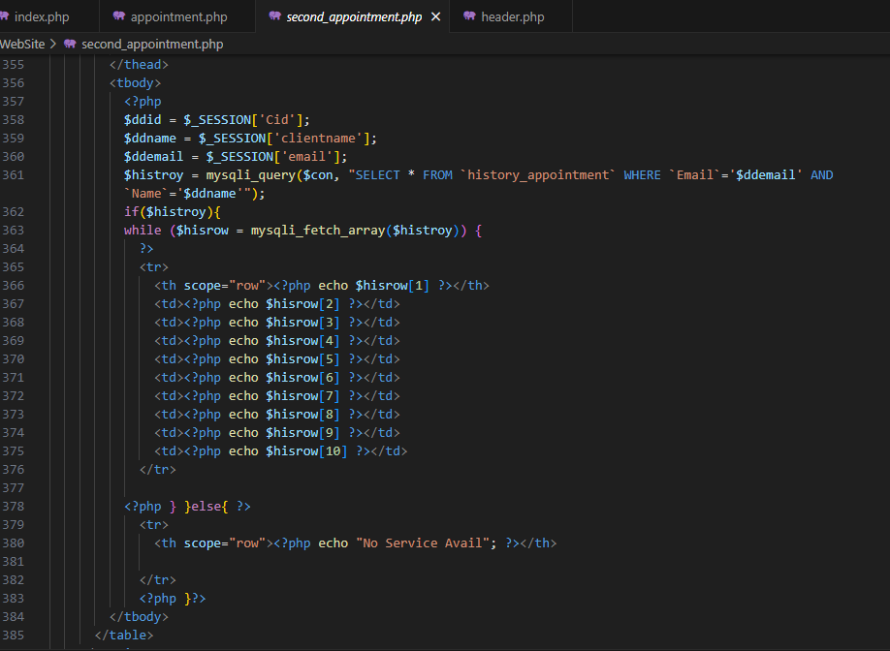
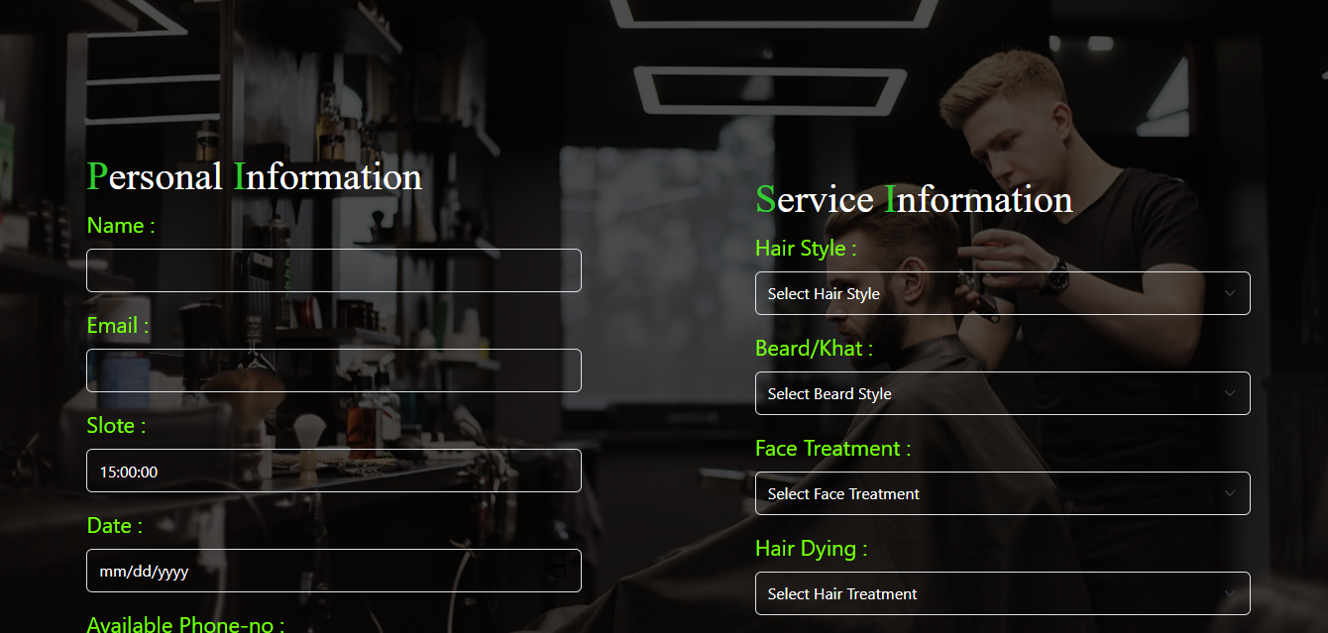
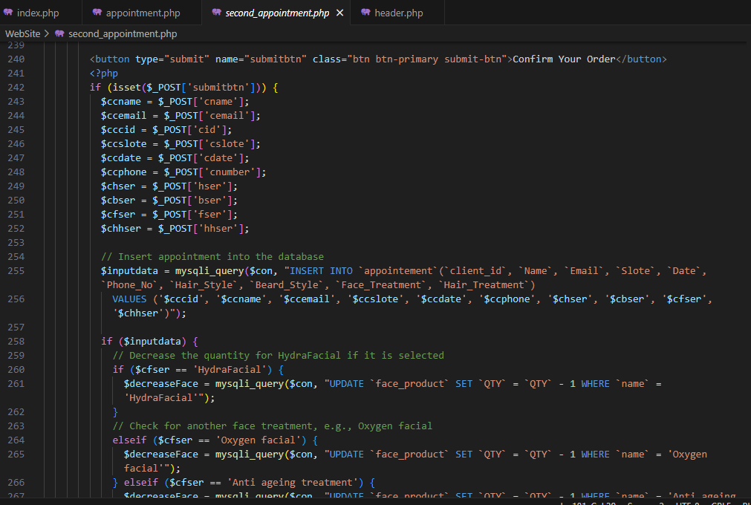
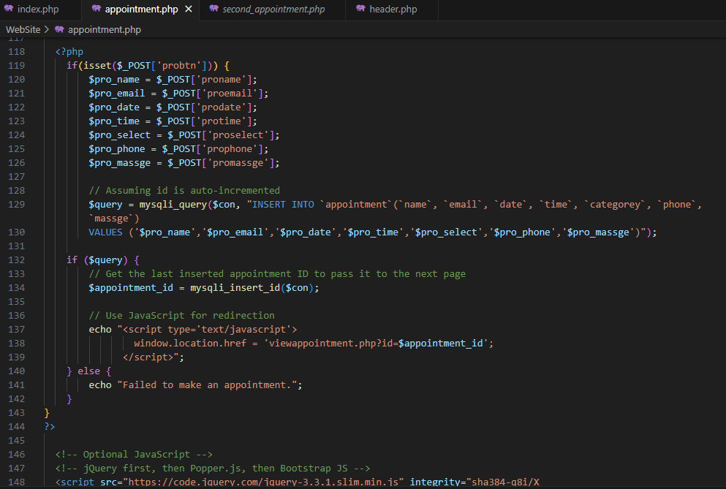
Appointment Management:
Users can view available time slots for different services.
Ability to book, reschedule, or cancel appointments.
Automated confirmation notifications (email/SMS) for booked appointments.
The system allows users to view available time slots for various services and manage their appointments by booking, rescheduling, or canceling. Automated email/SMS notifications confirm bookings and updates to keep users informed.

Slide 7
Client Management:
Maintain a centralized client database with details like name, contact information, services
availed, and appointment history.
Allow searching, adding, editing, and deleting client profiles.
Record client preferences for specific stylists or services.
The system maintains a centralized client database that includes details such as names, contact information, services availed, and appointment history. It allows for easy searching, adding, editing, and deleting of client profiles while also recording client preferences for specific stylists or services.

Slide 8
Inventory Management:
Track inventory levels for salon supplies (e.g., hair products, beauty supplies).
Receive alerts for low inventory and generate automatic purchase orders.
Record supplier information and cost details for inventory items.
The system monitors inventory levels for salon supplies, such as hair and beauty products, and sends alerts when stock is low. It can generate automatic purchase orders and maintains detailed records of supplier information and item costs for efficient inventory management.

Slide 9
Staff Management:
Manage staff profiles with details like name, contact information, work schedule, and
commission rates.
Enable the assignment of tasks, shifts, and services to stylists.
Calculate and track commissions based on services performed.
The system allows for comprehensive management of staff profiles, including details like name, contact information, work schedules, and commission rates. It enables task and shift assignments to stylists, while also calculating and tracking their commissions based on the services they perform.

Slide 10
Scheduling and Calendar Integration:
Provide a calendar view for easy scheduling and managing of appointments and staff shifts.
Ability to sync appointments with external calendars (Google Calendar, iCal) for better
organization.
The system offers a calendar view for efficient scheduling and management of appointments and staff shifts. It includes the ability to sync with external calendars like Google Calendar and iCal, enhancing organization and ensuring users stay on top of their commitments.

Slide 11
Reporting and Analytics:
Generate reports on appointments, sales, inventory levels, and staff performance.
Provide insights into popular services, peak booking hours, and inventory usage trends.
The system can generate comprehensive reports on appointments, sales, inventory levels, and staff performance. These reports provide valuable insights into popular services, peak booking hours, and inventory usage trends, helping to inform business decisions and optimize operations.

Slide 12
Payment and Invoicing:
Record and manage payments made by clients for services rendered.
Generate invoices or receipts for services provided and products sold.
The system records and manages payments made by clients for services rendered, ensuring accurate financial tracking. It can also generate invoices or receipts for both services provided and products sold, streamlining the billing process and enhancing client transparency.

Slide 13
Notifications and Reminders:
Automated reminders for upcoming appointments to clients and staff members.
Notifications for low inventory, pending payments, or other critical updates.
The system sends automated reminders for upcoming appointments to both clients and staff members, helping to reduce no-shows. Additionally, it provides notifications for low inventory, pending payments, and other critical updates, ensuring all stakeholders stay informed and proactive in their responsibilities.

Slide 14
Thank you
Brita Tamm
502-555-0152
brita@firstupconsultants.com
www.firstupconsultants.com

